Slide 1
Windows Program with C/C++
Windows and Messages
FPT Software
Trainer Name – Trainer Unit

Slide 2
Agenda
Getting started
Windows Programming Model
Messages
Hook

Slide 3
Getting started
Windows enviroment
The first C program in Windows enviroment

Slide 4
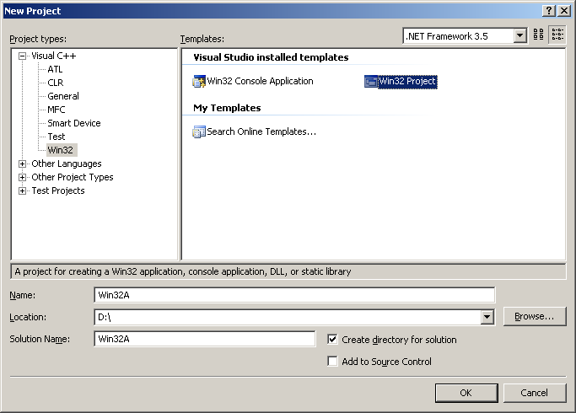
First program
Start Start the Microsoft Development Environment.
On the main menu, click File -> New... or File -> New -> Project...
In the New or New Project dialog box, click either Win32 Application or click Visual C++ Projects and Win32 Project:

Slide 5
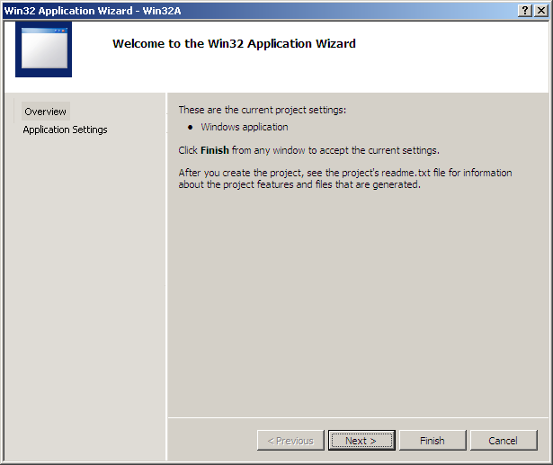
First program - cont
In the location, type the path where the application should be stored, such as D:
In the Name edit box, type the name of the application as Win32A and click OK
Click Finish

Slide 6
Structure of Windows program
WinMain() function
Windows Procedure
Other functions

Slide 7
Basic program flow
Register window class
Create window from window class
Show window
Create message loop for getting messages from operation system, of from application to itself and hanldling these messages

Slide 8
The main window class
WinMain tasks:
  Declare window class
  Register window class
  Create and display
  Get notifications
int APIENTRY WinMain(HINSTANCE hInstance,
HINSTANCE hPrevInstance,
LPTSTR lpCmdLine,
int nCmdShow)
hInstance, is a handle to the instance of the program you are writing
hPrevInstance, is used if your program had any previous instance. If not, this argument can be ignored
lpCmdLine, is a string that represents all items used on the command line to compile the application
nCmdShow, controls how the window you are building will be displayed

Slide 9
Window class
Windows defined window class as a struct
Name of struct : WNDCLASS
List fields of WNDCLASS struct :
  UINT style
  WNDPROC lpfnWndProc
  int cbClsExtra
  int cbWndExtra
  HANDLE hInstance
  HICON hIcon
  HCURSOR hCursor
  HBRUSH hbrBackground
  LPCTSTR lpszMenuName
  LPCTSTR lpszClassName

Slide 10
Window Extra-Memory
When an application has been launched and is displaying on the screen, which means an instance of the application has been created, the operating system allocates an amount of memory space for that application to use. If you think that your application's instance will need more memory than that, you can request that extra memory bytes be allocated to it. Otherwise, you can let the operating system handle this instance memory issue and initialize the cbWndExtra member variable to 0
  wndClass.cbClsExtra = 0;

Slide 11
The Main Window's Style
The style member variable specifies the primary operations applied on the window class. The actual available styles are constant values. For example, if a user moves a window or changes its size, you would need the window to be redrawn to get its previous characteristics. To redraw the window horizontally, you would apply the CS_HREDRAW. In the same way, to redraw the window vertically, you can apply the CS_VREDRAW.
The styles are combined using the bitwise OR (|) operator. The CS_HREDRAW and the CS_VREDRAW styles can be combined and assigned to the style member variable
  wndClass.style = CS_HREDRAW | CS_VREDRAW

Slide 12
The Application's Instance
Creating an application is equivalent to creating an instance for it. To communicate to the WinMain() function that you want to create an instance for your application, which is, to make it available as a resource, assign the WinMain()'s hInstance argument to your WNDCLASS variable
wndClass.hInstance = hInstance

Slide 13
Message Processing
The name of the window procedure must be assigned to the lpfnWndProc member variable of the WNDCLASS or WNDCLASSEX variable
wndClass.lpfnWndProc = WndProc
LRESULT CALLBACK WndProc(HWND hWnd, UINT Msg, WPARAM wParam, LPARAM lParam)
{
switch(Msg)
{
case WM_DESTROY:
PostQuitMessage(WM_QUIT);
break;
default:
return DefWindowProc(hWnd, Msg, wParam, lParam);
}
return 0;
}

Slide 14
The Application Main Icon
An icon can be used to represent an application in My Computer or Windows Explorer. To assign this small picture to your application, you can either use an existing icon or design your own. To make your programming a little faster, Microsoft Windows installs a few icons. The icon is assigned to the hIcon member variable using the LoadIcon() function
  wndClass.hIcon = HICON LoadIcon(HINSTANCE hInstance, LPCTSTR lpIconName);
The hInstance argument is a handle to the file in which the icon was created
The lpIconName is the name of the icon to be loaded. This name is added to the resource file when you create the icon resource
If you designed your own icon (you should make sure you design a 32x32 and a 16x16 versions, even for convenience), to use it, specify the hInstance argument of the LoadIcon() function to the instance of your application. Then use the MAKEINTRESOURCE macro to convert its identifier to a null-terminated string. This can be done as follows:
WndCls.hIcon = LoadIcon(hInstance, MAKEINTRESOURCE(IDI_STAPLE));

Slide 15
Introduction to Cursors
A cursor is used to locate the position of the mouse pointer on a document or the screen. To use a cursor, call the Win32 LoadCursor() function:
HCURSOR LoadCursor(HINSTANCE hInstance, LPCTSTR lpCursorName)
Example:
INT WINAPI WinMain(HINSTANCE hInstance, HINSTANCE hPrevInstance, LPSTR lpCmdLine, int nCmdShow)
{
WNDCLASSEX WndClsEx;
WndClsEx.cbSize = sizeof(WNDCLASSEX);
WndClsEx.style = CS_HREDRAW | CS_VREDRAW;
WndClsEx.lpfnWndProc = WndProcedure;
WndClsEx.cbClsExtra = 0;
WndClsEx.cbWndExtra = 0;
WndClsEx.hIcon = LoadIcon(NULL, IDI_APPLICATION);
WndClsEx.hCursor = LoadCursor(NULL, IDC_ARROW);
WndClsEx.hInstance = hInstance;
WndClsEx.hIconSm = LoadIcon(NULL, IDI_APPLICATION);
return 0;
}

Slide 16
The Application's Main Menu
If you want the window to display a menu, first create or design the resource menu (we will eventually learn how to do this). After creating the menu, assign its name to the lpszMenuName name to your WNDCLASS or WNDCLASSEX variable. Otherwise, pass this argument as NULL
Example:
INT WINAPI WinMain(HINSTANCE hInstance, HINSTANCE hPrevInstance, LPSTR lpCmdLine, int nCmdShow)
{
WNDCLASSEX WndClsEx;
WndClsEx.cbSize = sizeof(WNDCLASSEX);
WndClsEx.style = CS_HREDRAW | CS_VREDRAW;
WndClsEx.lpfnWndProc = WndProcedure;
WndClsEx.cbClsExtra = 0;
WndClsEx.cbWndExtra = 0;
WndClsEx.hIcon = LoadIcon(NULL, IDI_APPLICATION);
WndClsEx.hCursor = LoadCursor(NULL, IDC_ARROW);
WndClsEx.hbrBackground = GetStockObject(WHITE_BRUSH);
WndClsEx.lpszMenuName = NULL;
WndClsEx.hInstance = hInstance;
WndClsEx.hIconSm = LoadIcon(NULL, IDI_APPLICATION);
return 0;
}

Slide 17
The Window's Class Name
To create a window, you must provide its name as everything else in the computer has a name. The class name of your main window must be provided to the lpszClassName member variable of your WNDCLASS or WNDCLASSEX variable. You can provide the name to the variable or declare a global null-terminated string
Example:
ATOM MyRegisterClass(HINSTANCE hInstance)
{
WNDCLASSEX wcex;
wcex.cbSize = sizeof(WNDCLASSEX);
wcex.style = CS_HREDRAW | CS_VREDRAW;
wcex.lpfnWndProc = WndProc;
wcex.cbWndExtra = 0;
wcex.hInstance = hInstance;
wcex.hIcon = LoadIcon(hInstance, MAKEINTRESOURCE(IDI_WIN32A));
wcex.hCursor = LoadCursor(NULL, IDC_ARROW);
wcex.hbrBackground = (HBRUSH)(COLOR_WINDOW+1);
wcex.lpszMenuName = MAKEINTRESOURCE(IDC_WIN32A);
wcex.lpszClassName = szWindowClass;
wcex.hIconSm = LoadIcon(wcex.hInstance, MAKEINTRESOURCE(IDI_SMALL));
return RegisterClassEx(&wcex);
}

Slide 18
Register window class
Declare an struct variable that has type is WNDCLASS like below :
  WNDCLASS wndClass;
Set value for window class’s fields
  wndClass.style = CS_HREDRAW | CS_VREDRAW
  wndClass.lpfnWndProc = WndProc;
  wndClass.cbClsExtra = 0;
  wndClass.cbWndExtra = 0;
  wndClass.hInstance = hInstance;
  wndClass.hIcon = LoadIcon(NULL, IDI_APPLICATION);
  wndClass.hCursor = LoadCursor(NULL, IDC_ARROW);
  wndClass.hbrBackground = (HBRUSH) GetStockObject(WHITE_BRUSH);
  wndClass.lpSzMenuName = NULL;
  wndClass.lpSzClassName = szAppName;

Slide 19
Register window class
Register window class :
  If (!RegisterClass( &wndClass))
  {
  MessageBox ( NULL, TEXT(“This program requires Windows NT”), szAppName, MB_ICONERROR);
  return 0;
  }

Slide 20
Create Window
Window class defines common properties for one window. Base on window class, we could create different windows by call Win32 APPI : CreateWindow() function
HWND CreateWindow(
  LPCTSTR lpClassName,
  LPCTSTR lpWindowName,
  DWORD dwStyle,
  int x,
  int y,
  int nWidth,
  int nHeight,
  HWND hWndParent,
  HMENU hMenu,
  HANDLE hInstance,
  PVOID lpParam );

Slide 21
Show Window
After create window, window is not appeared on screen, we must call ShowWindow() function for display window on screen :
ShowWindow(hWnd, iCmdShow);
For update client area of window, we must call UpdateWindow() function for re-draw client area of window on screen :
UpdateWindow(hWnd);

Slide 22
Messages Loop
After window has been created, displayed on screen, application is ready for handle all of events are occurred by interaction between user and application
When an event occurs, Windows translates event to a “message” then place this message in application’s message queue
For handle events, application must get messages from message queue then send messages to message handlers that are defined in window procedure

Slide 23
Message Loop
Get messages from message queue :
  MSG msg;
  While (GetMessage(&msg, NULL, 0, 0))
  {
    TranslateMessage(&msg);
    DispatchMessage(&msg);
    }
The MSG struct contains message information from message queue
typedef struct tagMSG {
    HWND hwnd ; // handle of windows that get message
    UINT message ; // message identifier
    WPARAM wParam ; // additional information about message
    LPARAM lParam ; // additional information about message
    . . .
    } MSG;
For wParam and lParam, the exact meaning depends on the value of the message member. For WM_LBUTTONDOWN it is the state of the Ctrl or Shift keys, and the mouse coordinates.

Slide 24
Window's Message Decoding (1)
Once a window has been created, the user can use it. This is done by the user clicking things with the mouse or pressing keys on the keyboard. A message that a window sends is received by the application. This application must analyze, translate, and decode the message to know what object sent the message and what the message consists of. To do this, the application uses the GetMessage() function.
BOOL GetMessage(LPMSG lpMsg, HWND hWnd, UINT wMsgFilterMin, UINT wMsgFilterMax)
  lpMsg argument is a pointer to the MSG structure
  hWnd argument identifies which window sent the message. If you want the messages of all windows to be processed, pass this argument as NULL.
  wMsgFilterMin and the wMsgFilterMax arguments specify the message values that will be treated. If you want all messages to be considered, pass each of them as 0

Slide 25
Window's Message Decoding (2)
Once a message has been sent, the application analyzes it using the TranslateMessage() function. This function takes as argument the MSG object that was passed to the GetMessage() function and analyzes it. If this function successfully translates the message, it returns TRUE. If it cannot identify and translate the message, it returns FALSE
BOOL TranslateMessage(CONST MSG *lpMsg)
Once a message has been decoded, the application must send it to the window procedure. This is done using the DispatchMessage() function. This DispatchMessage() function sends the lpMsg message to the window procedure. The window procedure processes it and sends back the result, which becomes the return value of this function
LRESULT DispatchMessage(CONST MSG *lpMsg)

Slide 26
Window procedure
Contains message hanlder for handling event occurs of application
Prototype :
  LRESUTL CALLBACK WndProc(
    HWND hWnd,
    UINT message,
    WPARAM wParam,
    LPARMA lParam)

Slide 27
Window procedure
Window procedure is always called from Windows
One program could call window procedure by call Win32 API function : SendMessage()
Basic flow of message handling in window procedure :
  Switch (Message id) {
    Case WM_CREATE :
    // handle message WM_CREATE
    Return 0;
    Case [Other message] :
    // hanlde message
    Return 0;
    Case WM_PAINT :
    // hanlde message WM_PAINT
    Return 0;
    Case WM_DESTROY :
    // hanlde message WM_DESTROY
    Return 0;
    }
    Return DefWindowProc(hWnd, iMsg, wParam, lParam);

Slide 28
Messages, Messages, and Messages
Message Sent When
WM_CHAR A character is input from the keyboard.
WM_COMMAND The user selects an item from a menu, or a control sends a notification to its parent.
WM_CREATE A window is created.
WM_DESTROY A window is destroyed.
WM_LBUTTONDOWN The left mouse button is pressed.
WM_LBUTTONUP The left mouse button is released.
WM_MOUSEMOVE The mouse pointer is moved.
WM_PAINT A window needs repainting.
WM_QUIT The application is about to terminate.
WM_SIZE A window is resized.

Slide 29
Sending Messages
The messages we have used so far belong to specific events generated at a particular time by a window. Sometimes in the middle of doing something, you may want to send a message regardless of what is going on. This is made possible by a function called SendMessage()
LRESULT SendMessage(HWND hWnd, UINT Msg, WPARAM wParam, LPARAM lParam);
  The hWnd argument is the object or control that is sending the message.
  The Msg argument is the message to be sent
  The wParam and the lParam values depend on the message that is being sent
The advantage of using the SendMessage() function is that, when sending this message, it would target the procedure that can perform the task and this function would return only after its message has been processed. Because this (member) function can sometimes universally be used, that is by any control or object, the application cannot predict the type of message that SendMessage() is carrying
In order to send a message using the SendMessage() function, you must know what message you are sending and what that message needs in order to be complete. For example, to change the caption of a window at any time, you can use the WM_SETTEXT message. The syntax to use would be:
SendMessage(hWnd, WM_SETTEXT, wParam, lParam)

Slide 30
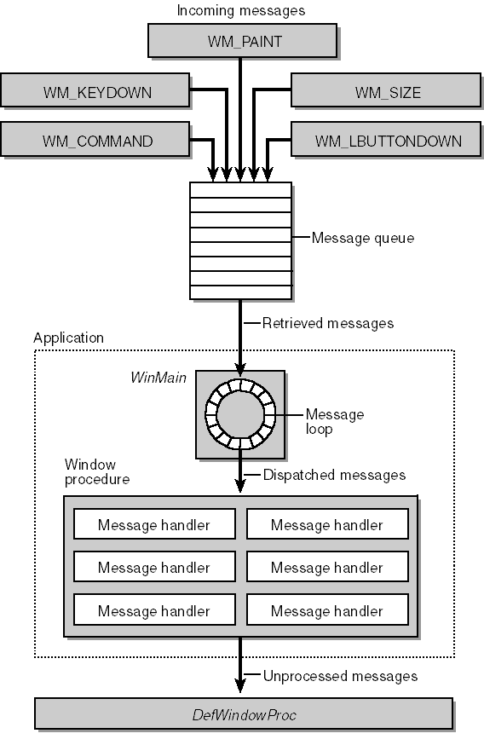
Summary

Slide 31
Hooks
Overview about hook
Hook Types
Hook Scopes
Win32 API Related to Hook
Sample code to implement hook
Hook Example

Slide 32
Overview about hook
Hook is a technique to intercept events, such as messages, mouse actions and keystrokes before these events are sent to windows procedure
Hook procedure: a function that intercepts a particular type of event is known as hook procedure. After hook procedure processes events, it can modify or discard the event.
Hook chain: A hook chain is a list of pointers to special, application-defined callback functions called hook procedures
Each type of hook enable an application monitor a different aspect of the system's message-handling mechanism
Refer to below link for detail about each hook type and corresponding hook procedure
http://msdn.microsoft.com/en-us/library/windows/desktop/ms644959(v=vs.85).aspx
Hooks tend to slow down the system because they increase the amount of processing the system must perform for each message => Only use when necessary
Notes:
A hook chain is a list of pointers to special, application-defined callback functions called hook procedures. When a message occurs that is associated with a particular type of hook, the system passes the message to each hook procedure referenced in the hook chain, one after the other. The action a hook procedure can take depends on the type of hook involved. The hook procedures for some types of hooks can only monitor messages; others can modify messages or stop their progress through the chain, preventing them from reaching the next hook procedure or the destination window

Slide 33
Hook Types
Below is some common hook type
WH_CALLWNDPROC
  monitor messages sent to window procedures
WH_GETMESSAGE
  monitor messages about to be returned by the GetMessage or PeekMessage function
WH_KEYBOARD_LL
  monitor keyboard input events about to be posted in a thread input queue
WH_KEYBOARD
  monitor message traffic for WM_KEYDOWN and WM_KEYUP messages about to be returned by the GetMessage or PeekMessage function
WH_MOUSE_LL
  monitor mouse input events about to be posted in a thread input queue
WH_MOUSE
  monitor mouse messages about to be returned by the GetMessage or PeekMessage function.

Slide 34
Hook Scopes
Global Hooks, process all input of the appropriate type for the entire OS and must be in a DLL
Thread Hooks, process all input of the appropriate type for that process or thread
Name | Scope | Hook procedure
WH_CALLWNDPROC | Global/Thread | CallWndProc
WH_GETMESSAGE | Global/Thread | GetMsgProc
WH_KEYBOARD_LL | Global | LowLevelKeyboardProc
WH_KEYBOARD | Global/Thread | KeyboardProc
WH_MOUSE_LL | Global | LowLevelMouseProc
WH_MOUSE | Global/Thread | MouseProc

Slide 35
Win32 API Related to Hook
Hook procedure
  LRESULT CALLBACK HookProc( int nCode, WPARAM wParam, LPARAM lParam )
  {
  ………………………
  }
Below is some common hook type
SetWindowsHookEx
  Installs an application-defined hook procedure into a hook chain
UnhookWindowsHookEx
  Removes a hook procedure installed in a hook chain
CallNextHookEx
  Passes the hook information to the next hook procedure in the current hook chain
Note
Don’t use the non-Ex versions, as they are for windows 3.x
Include windows.h header when use

Slide 36
Win32 API Related to Hook
SetWindowsHookEx
Return handle to the hook procedure when success
If the function fails, the return value is NULL
HHOOK SetWindowsHookEx
(
int idHook, //type of hook procedure
HOOKPROC lpfn, //pointer to the hook procedure
HINSTANCE hMod, //handle to the DLL containing the hook procedure
DWORD dwThreadId //thread id
);
The hMod parameter must be set to NULL if
  dwThreadId specifies a thread created by the current process
  lpfn is within the code associated with the current process
If lpfn in a dll, hMod must be the instance of the DLL

Slide 37
Win32 API Related to Hook
UnhookWindowsHookEx
Return nonzero to the hook procedure when success
Return zero when function fails
BOOL UnhookWindowsHookEx
(
HHOOK hhk //handle to the hook to be removed
);
Hooks don’t attach and detach immediately after SetWindowsHookEx and UnhookWindowsHookEx. Because windows hooks are all about messages, the hook isn't really mapped or unmapped until an adequate event happens

Slide 38
Win32 API Related to Hook
CallNextHookEx
If you want to have windows continue processing the hook, your processing function should return this function
To discard return 0
LRESULT CallNextHookEx
(
HHOOK hhk, //just pass NULL for it
int nCode, //hook code
WPARAM wParam, //value passed to the current hook procedure
LPARAM lParam //value passed to the current hook procedure
);

Slide 39
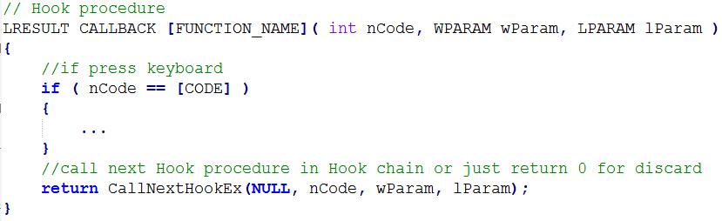
Step to implement hook
Step 1: Create hook procedure. Prototype of hook procedure is followed hook type. Content of hook procedure is as below
[FUNCTION_NAME] : is name of hook procedure
[CODE] : is hook code

Slide 40
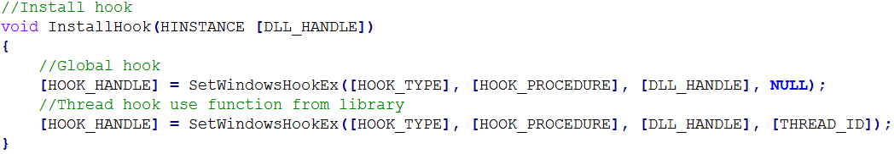
Step to implement hook
Step 2: Implement method to install hook. Set [THREAD_ID] to NULL if want to create global hook
[HOOK_HANDLE] : is kept to use when released hook
[HOOK_PROCEDURE] : is address of hook procedure
[DLL_HANDLE] : is handle of dll that contains hook procedure
[THREAD_ID] : is thread id of thread want to hook

Slide 41
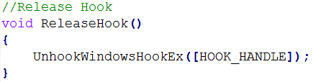
Step to implement hook
Step 3: Implement method to release hook
[HOOK_HANDLE] : is handle fo hook want to release

Slide 42

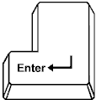
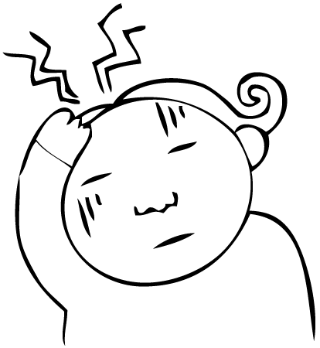
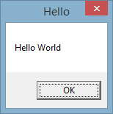
Example
Example: Install global hook to show message box when Enter key is pressed

Slide 43
Example
Step 1: Create a dll ( Ex: TestHook.dll ) to contain
  hook procedure
  Method to install hook
  Method to release hook
Step 2: Create a MFC dialog, in OnInitDialog method, load TestHook.dll and call method to install hook
Step 3: On OnDestroy method of dialog application, call method to release hook

Slide 44
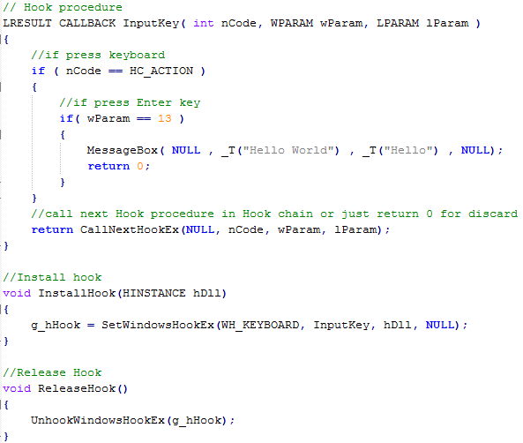
Example
Sample code of
TestHook.dll

Slide 45
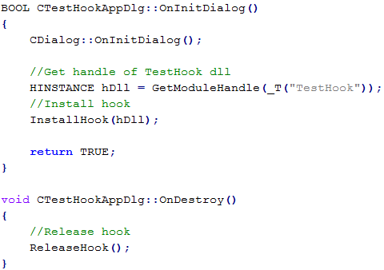
Example
Sample code of MFC application

Slide 46
Hungary notation
Prefix Data Type
b BOOL
c or ch char
clr COLORREF
cx, cy Horizontal or vertical distance
dw DWORD
h Handle
l LONG
n int
p Pointer
sz Zero-terminated string
w WORD
wnd CWnd
str CString
m_ class member variable
Note:
Prefixes can be combined:
pszName
m_nAge

Slide 47
DISCUSSION

